Slide 1
Mohican Indians
Essential Question:
Who were the Mohican Indians and why were they important?
By: Brianna Croce, Anne Eisner, Caitlyn Yackeren

Slide 2
Table of Contents
History
Geography
Culture
Clothes
Food
Habitat
Famous People

Slide 3
History
Mohican is pronounced "muh-HEE-can." It comes from the word Muheconneok, which means "from the waters that are never still." That is the Mohican name for the Hudson River.
- The Mohican people were first recorded in history on Sept. 15th 1609 by Henry Hudson
- They were recorded as being a “loving people.”
- The Dutch created a fur trade in the area in 1609
- The Mohican lost 90% of their population to epidemics.
- The Mohicans went to war with the Mohawks over trade with the Dutch.
- In 1736 the Mohicans founded the town Stockbridge, in Massachusetts as a way to try and some land and preserve their way of life.
-The Mohican tribe was the only tribe that wholly supported the colonists during the french and indian war.
- When they returned from war their homes were bought by their neighbors, and they were forced out of the land.
- In 1783, most of the tribe move to central New York and settled with the Oneida Indians and later settled on reservation farther inland, most of the tribe settling in Wisconsin by 1856
Notes:
http://absolutraining.com/atwp/wp-content/uploads/2012/02/left-arrow-icon.jpg ,http://www.bigorrin.org/mohican_kids.htm,http://endahkee.nativeweb.org/mohicans.html

Slide 4
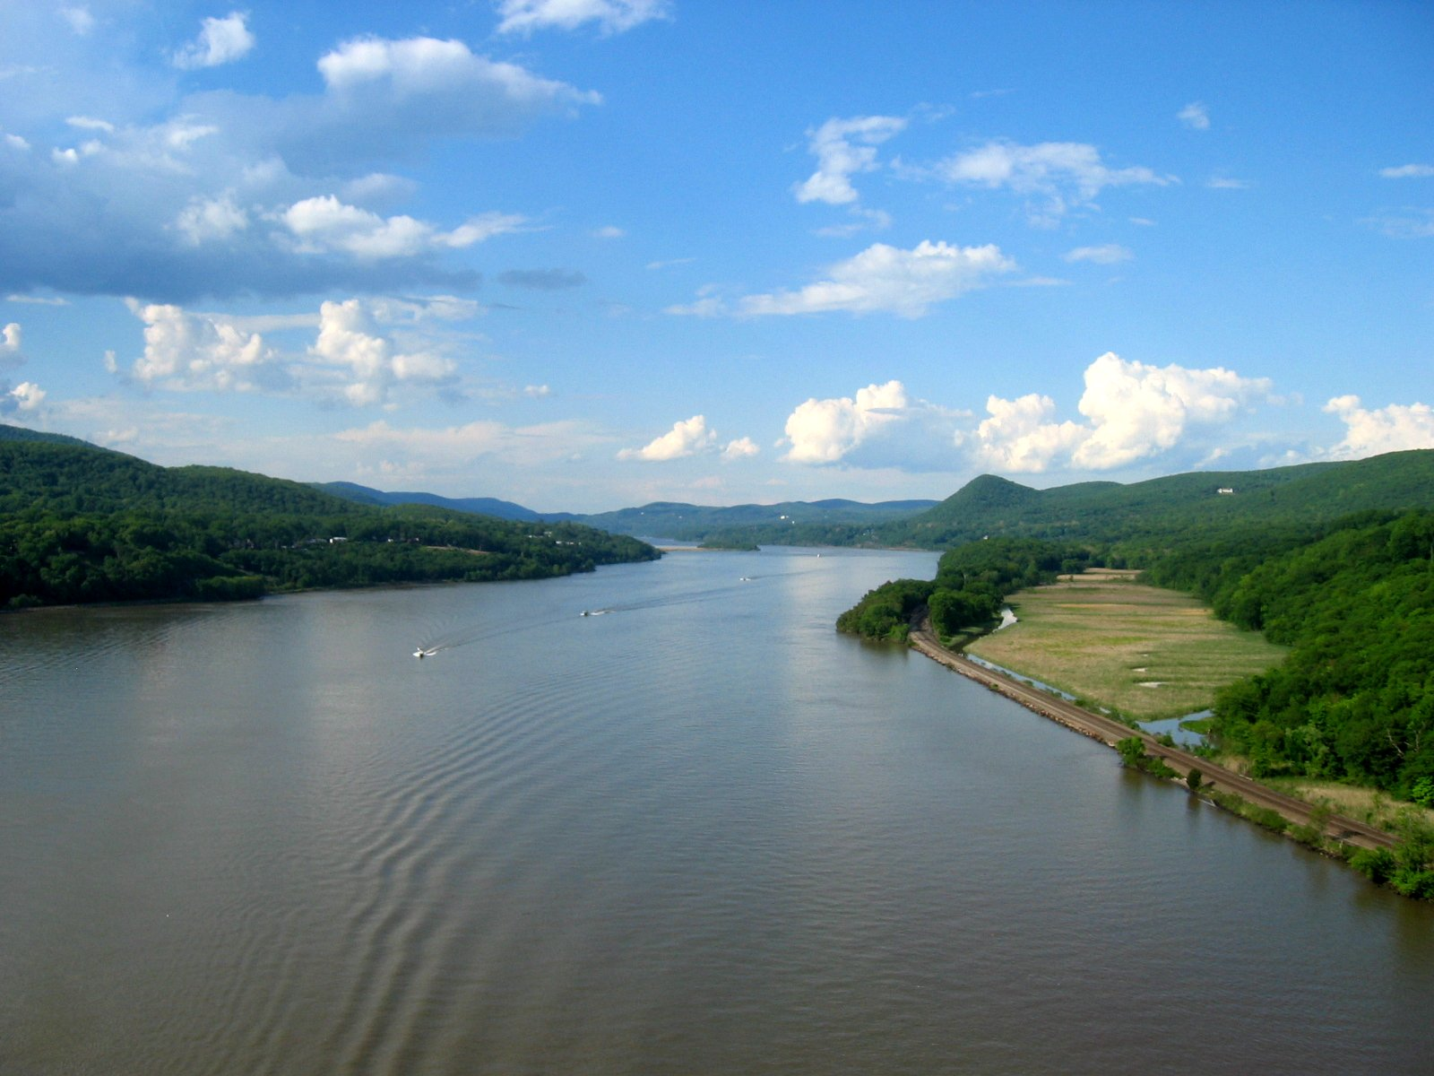
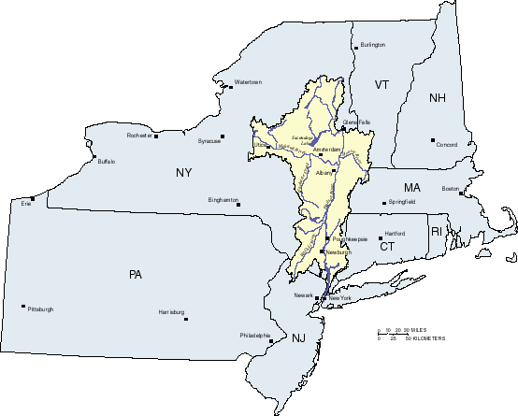
Geography
Settled along the Hudson River in New York State
The people tended to settle around rivers - for food, water, and shelter.
Notes:
resource:http://www.native-languages.org/mohican.htm
http://www.mohican-nsn.gov/Departments/Library-Museum/Mohican_History/origin-and-early.htm

Slide 5
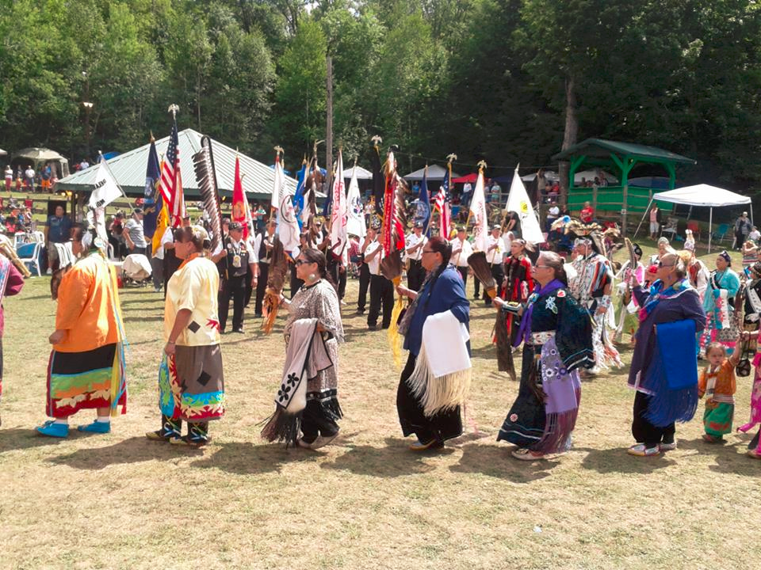
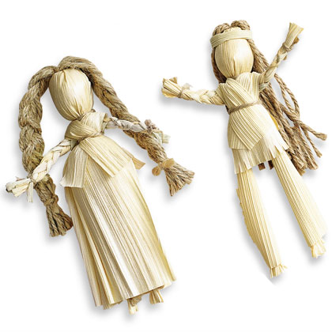
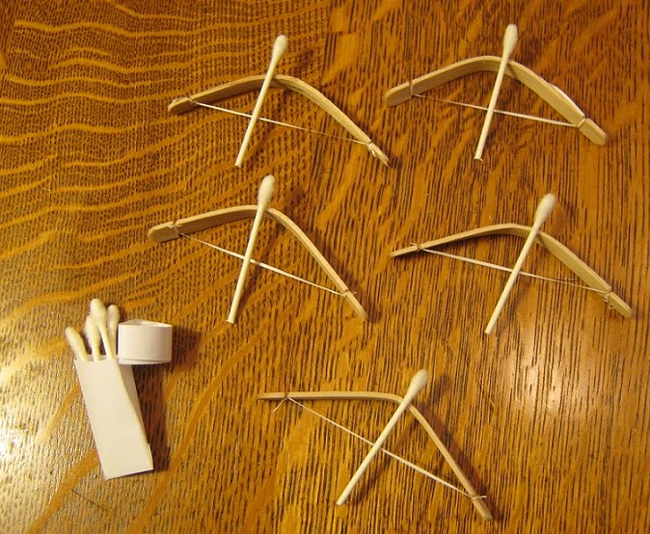
Culture
Language - their own Mohican language and they called themselves Muh-he-con-neok
Religion - The Mohican Indians had many religious beliefs, and still continue to fight for their religious freedoms.
Traditions - Elders would tell stories to the children, which passes down their history religion and culture.
Customs - Hunting, making clay pots, gardening
Songs - “Núcanchi Nan”, “The last of the Mohicans”
Games - Children played ball games
Dances - “The Great Mohican Pow-Wow”
Toys - corn shuck dolls, and toys such as miniature bows and arrows.
Notes:
resources:http://www.bigorrin.org/mohican_kids.htm
http://www.wisegeek.com/what-is-the-mohican-tribe.htm

Slide 6
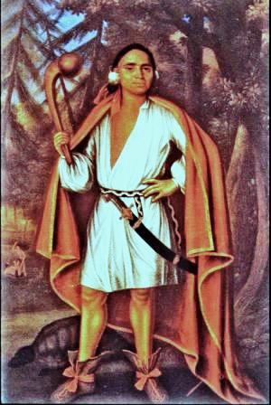
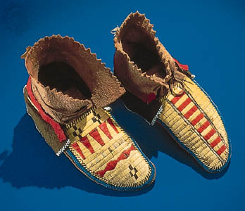
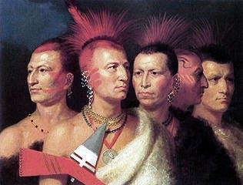
Clothing
- Men used European clothing and adapted it for their own style
- Men wore feathers in their hair and jewelry
- Mohican women wore skirts with leggings.
-Mohican people wore moccasins on their feet.
Notes:
http://www.ic-migration.webhost.uits.arizona.edu/icfiles/ic/kmartin/School/iroqcloth.htm
http://www.bigorrin.org/mohican_kids.htm

Slide 7
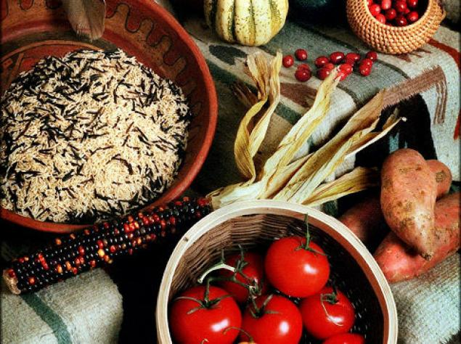
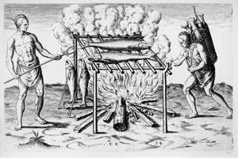
Food
-Meats:deer, moose, turkeys, and small game
-Vegetables (especially corn beans and squash)
-Berries
-Nuts
-Fish
-Mohican recipes included soup, cornbread, and trail mix
Notes:
resource:http://www.mohican-nsn.gov/Departments/Library-Museum/Mohican_History/origin-and-early.htm
http://www.bigorrin.org/mohican_kids.htm

Slide 8
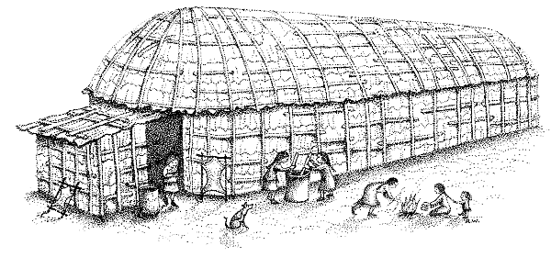
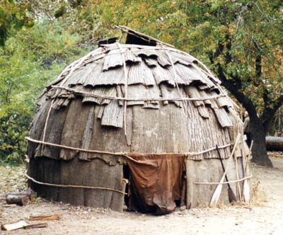
Habitat
Their homes, called wigwams, (wigwams), were circular and made of bent sapling covered with hides or bark.
They also lived in longhouses which were often very large, sometimes as long as a hundred feet.
The roofs were curved and covered with bark, except for smoke homes which allowed the smoke from fire pits to escape.
Several families from the same clan might live in a longhouse, each family having its own section.
Notes:
http://www.mohican-nsn.gov/Departments/Library-Museum/Mohican_History/origin-and-early.htm

Slide 9
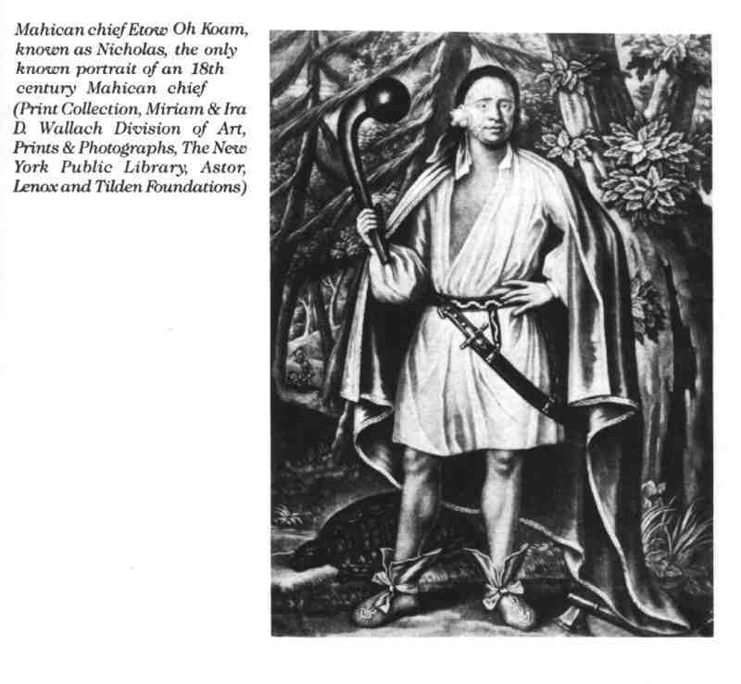
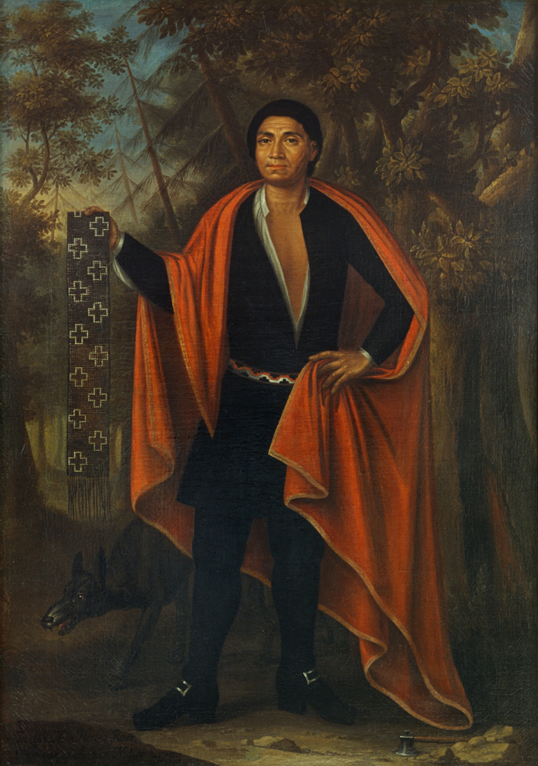
Famous People
Mohican Etowaukaum (Nicholas) Mohawk Hendrick (whose father was a Mohican)
While in England, the chiefs spoke of missionaries
Notes:
http://www.mohicanpress.com/mo08014.html

Slide 10
Resources
Mohican Indian Fact Sheet. Facts for Kids: Mohican Indians (Mohicans, Wappingers, and Stockbridge Indians). Retrieved from http://www.bigorrin.org/mohican_kids.htm
THE MOHICANS ... Children of the Delaware. THE MOHICANS ... Children of the Delaware. Retrieved from http://www.mohicanpress.com/mo08014.html
Native Languages of the Americas: Mohican (Mahican, Stockbridge, Wappinger). Mohican Language and the Mohican Indian Nation (Wappinger, Mahican, Stockbridge Indians). Retrieved from http://www.native-languages.org/mohican.htm
Newman, E., & Wilborn, C. (2013, October 13). WiseGeek. Retrieved from http://www.wisegeek.com/what-is-the-mohican-tribe.htm
Welcome to Mohican Country. N'DahAhki. Retrieved from http://endahkee.nativeweb.org/mohicans.html
Origin and Early Mohican History. Retrieved from http://www.mohican-nsn.gov/Departments/Library-Museum/Mohican_History/origin-and-early.htm

